Slide 1
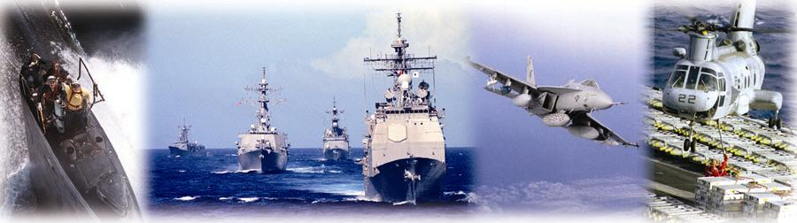
NAVSUP Weapon Systems Support
presented by:
Craig Pulver

Slide 2
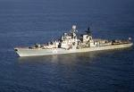
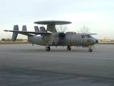








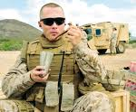
Who We Are
The mission of NAVSUP Weapon Systems Support is to procure systems, components, spare parts and overhaul/repair services in support of worldwide aviation and shipboard operations of the U. S. Navy, U.S. Marine Corps, other military departments, foreign military and to train our customers.
For WSS, the WSS Industrial Support Expediting Cell has been recalling excess material for RL, backorders, initial outfitting and repair avoidance. We are now expanding into training.
2

Slide 3

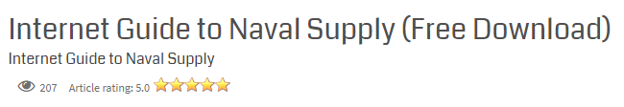
Industrial Support Training
Developed a suite of training products to support our training initiatives
  Book, Quick Refs and Videos
  Hosted on the LogTool.com web site and My NAVSUP for secure downloads
Book: Internet Guide for Naval Supply
  Developed to provide an overview of logistic internet based tools
  Currently used by the WSS Industrial Support Expediting Cell to obtain
    status of requisitions
    find parts to solve backorders
    track shipments.

Slide 4
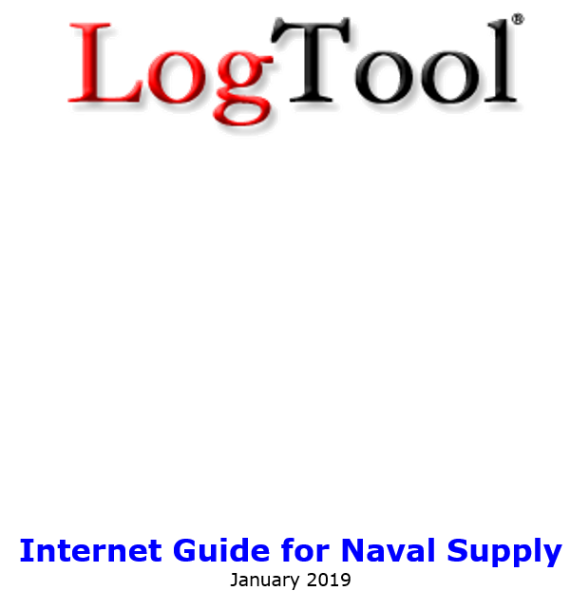
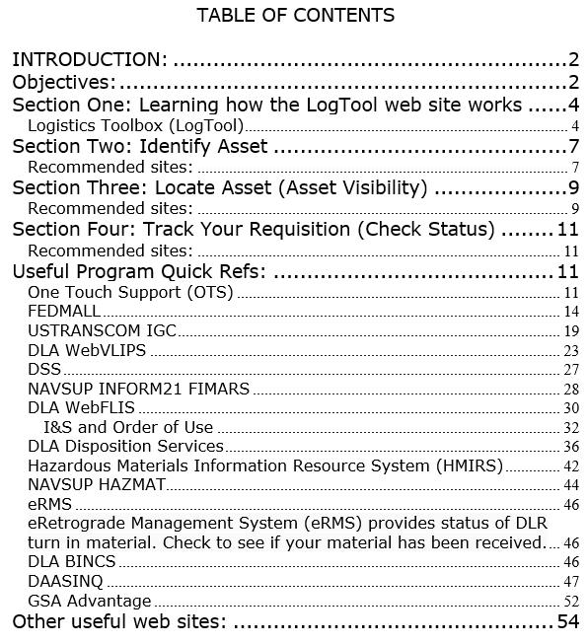
Training material is available for download

Slide 5
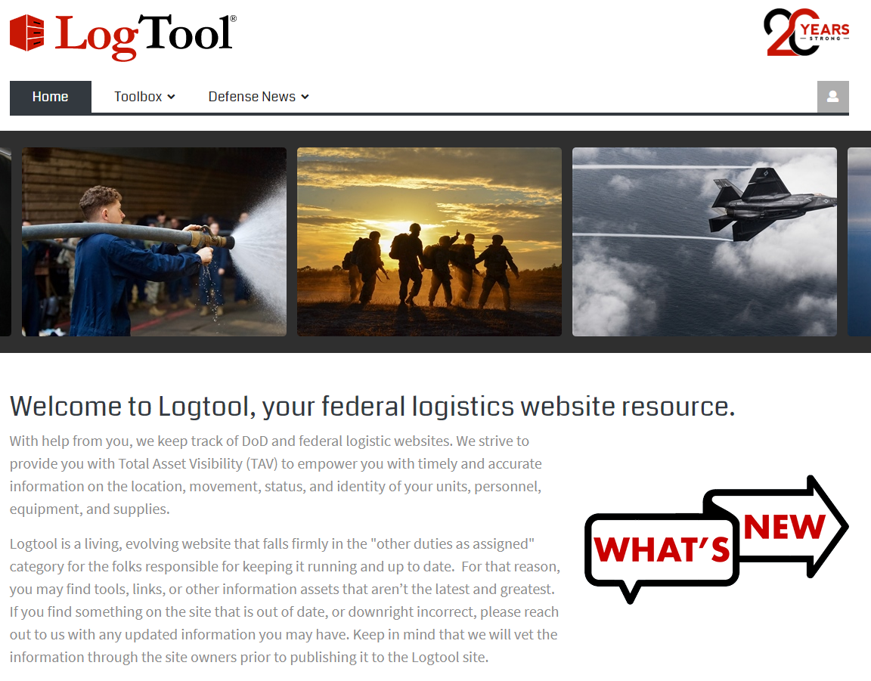
How to use the LogTool web site
The LogTool web site was developed at WSS and has been used by WSS for the past 20 years!
The new LogTool web site Home page
starts with DoD Photos.
Mouse over Toolbox to enter LogTool
When you type http://logtool.com in your browser address window, you will get the above page

Slide 6
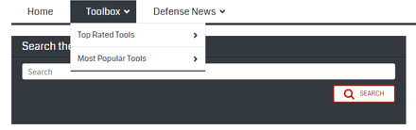
Navigating the LogTool website
The Navy unique pages have many of the systems you may have bookmarked today
  There are 4 choices to find what you are looking for
    Alphabetical listing, Top Rated Tools or Most Popular Tools and Search

Slide 7
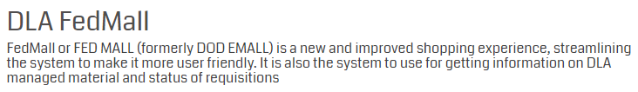
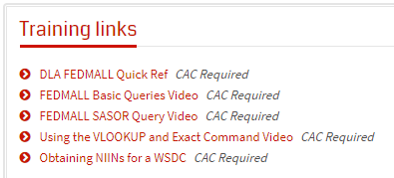
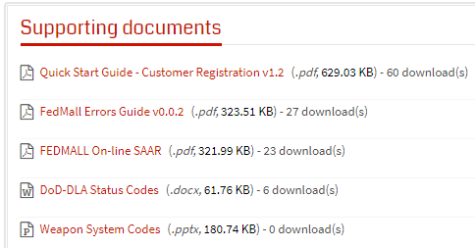
WSS Training
Our plan is to introduce the WSS workforce to a new program each month
  DLA FEDMALL is the first program since visibility of DLA managed material is critical to the successful support of Navy’s weapon systems and supports our PSICP mission
The LogTool web site is loaded with help to remind you what we are going to do today and things you may want to try

Slide 8
Our Philosophy
Today, no one system does everything
  No one perfect system
  Multiple systems may be required
  If one system goes down, what else can you use
Selecting the right system, based on
  System capabilities
  Your job requirements
  Information needed

Slide 9
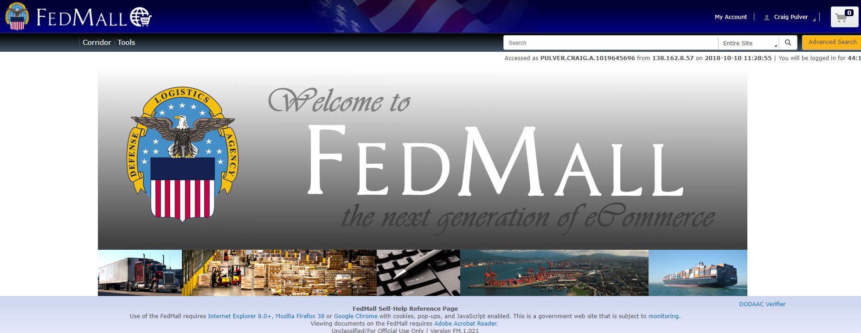
Today’s Training is DLAs FEDMALL
DLA’s DoD FEDMALL
Technical Screening
for DLA and Commercial
material
DLA Asset Visibility
Supportability Analysis (SA-SOR)
Tracks Status
Weapon System Data (Very important)

Slide 10
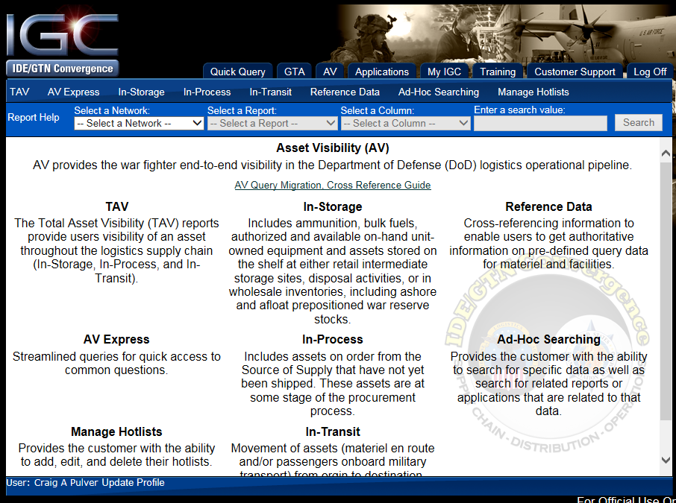
Some of the Systems We Train:
TRANSCOM’s IGC
Provides real-time access to requisition status in batch
Batch query of FLIS data
Total asset visibility of all Services
One of the most powerful programs in DoD

Slide 11
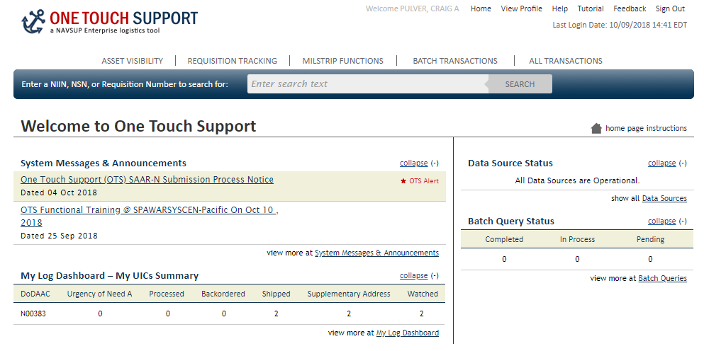
Some of the systems we will train:
NAVSUP’s OneTouch
  Backup for ERP data

Slide 12
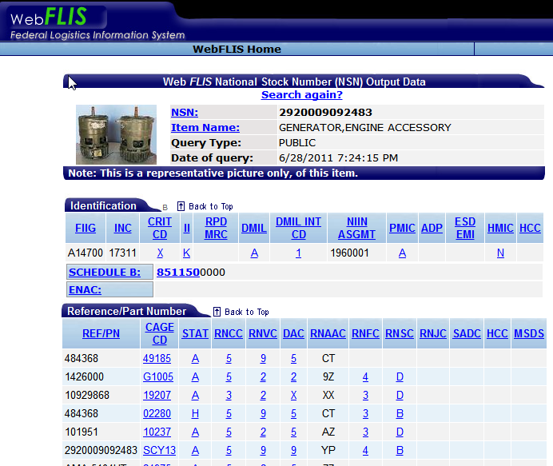
Some of the Systems We Train:
DLA’s WebFLIS
  Occasionally Navy isn’t a registered user or ERP thinks Navy manages a NIIN but it is actually managed by DLA. FLIS is the bible

Slide 13
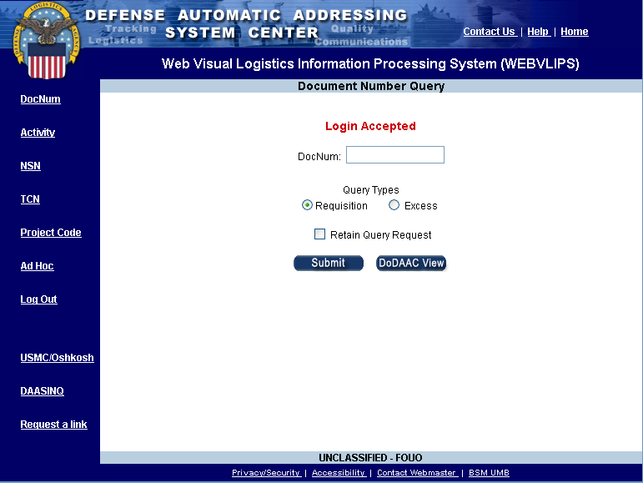
Some of the Systems We Train:
DLA’s WebVLIPS
Provides real-time access
to transaction information
that has passed through
DAAS
Inventory Control Points
& Distribution Depots
send status on customers’
requisitions
Get current status, shipping
and tracking information

Slide 14
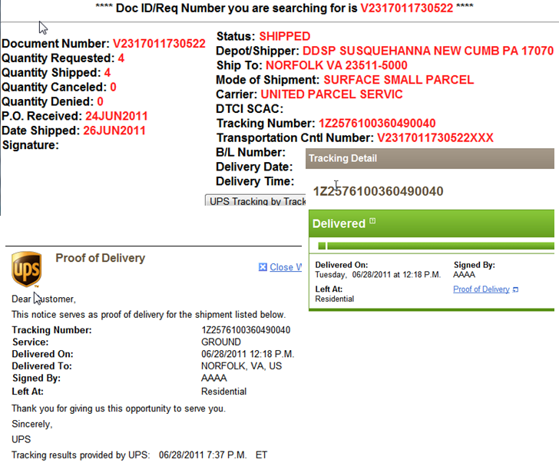
Some of the Systems We Train:
USTRANSCOM’s DSS
  Real-time shipping status
  No Login required
  Links to Shipping companies
  Allows batch up to 60 DOCs

Slide 15
POC Info:
Peter Browne
peter.s.browne@navy.mil
(215) 697-5056
Craig Pulver
craig.a.pulver.ctr@navy.mil
(215) 697-4639
Gary Condit
gary.e.condit.ctr@navy.mil
(215)-697-4726

