Slide 1
SPR Batch Submission
Uploading SPRs in FedMall
August 2017
Ready. Resourceful. Responsive!

Slide 2
Background
At the end of a CART-FOO project, 9 COG items are segregated from WSS managed items
  SPRs should be loaded for those 9 COG allowanced items
FedMall recently replaced Dod Emall and is now the site to bulk load 9 COG SPRs
The following slides illustrate:
  Steps to load bulk SPRs
  How to appropriately format a SPR text file to upload in FedMall
  How to view SPRs loaded in FedMall

Slide 3
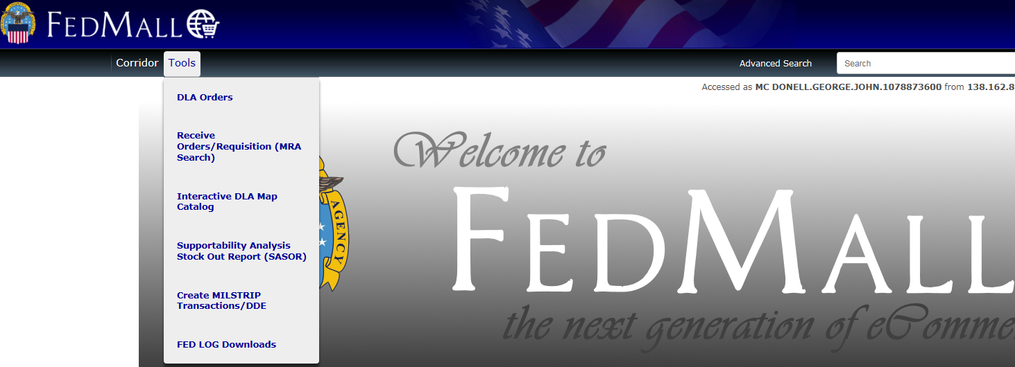
Step By Step Upload
From the FedMall home screen under tools select Create MILSTRIP transactions/DDE.

Slide 4
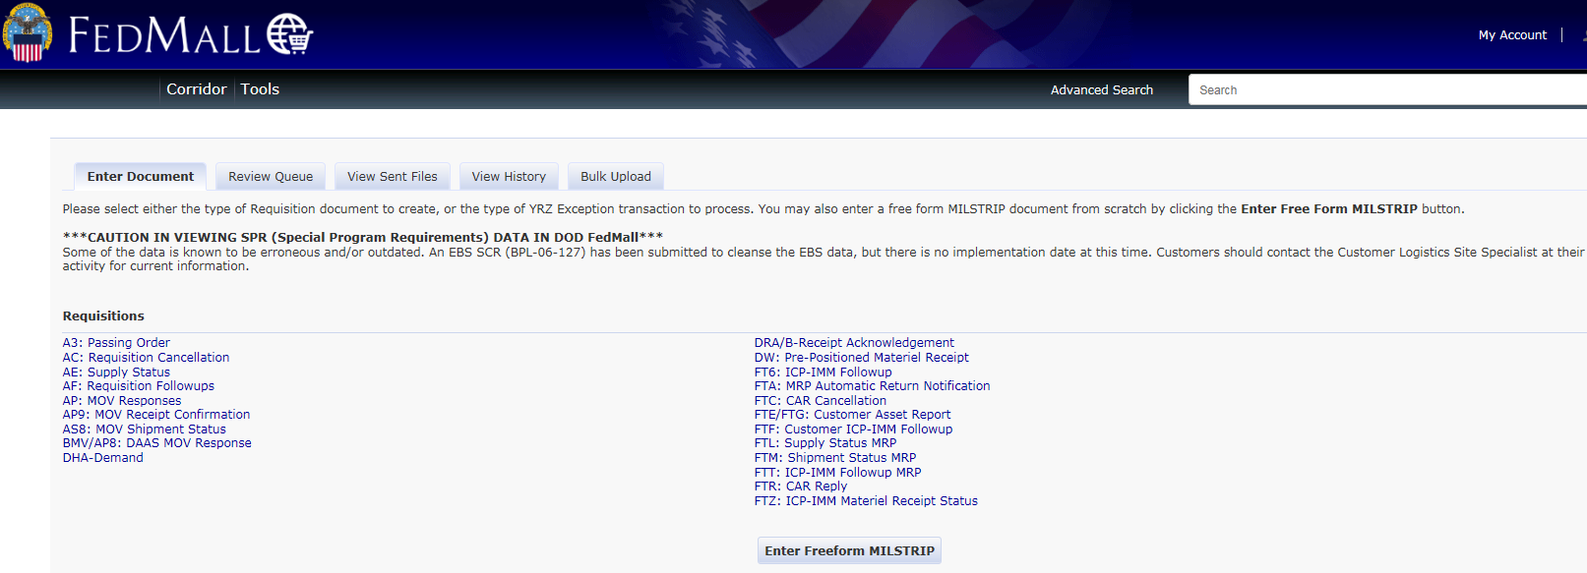
Step By Step Upload
Select Bulk Upload

Slide 5
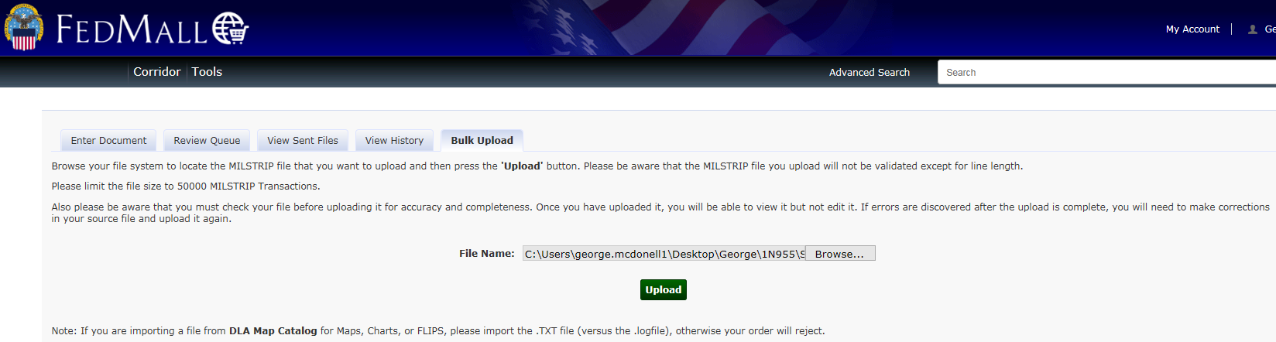
Step By Step Upload
The example is for Assault Craft Unit (ACU) 5 LCAC SPRs
Select previously formatted text file from your desktop and click upload
Inserted file can be used as a template

Slide 6
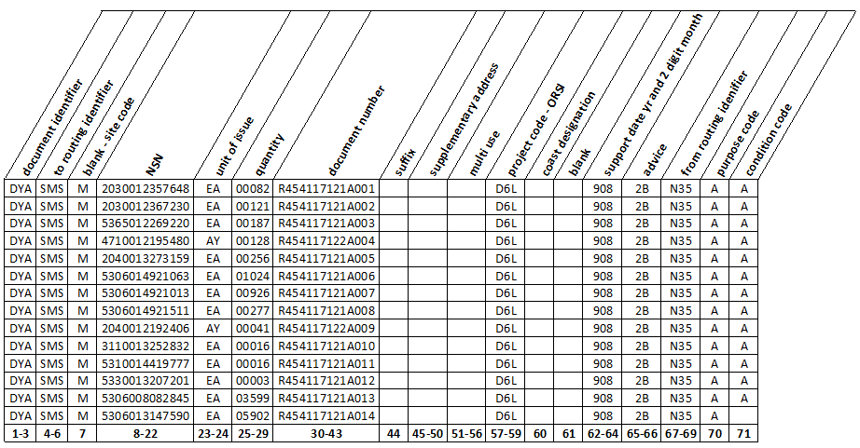
Sample Text File Format

Slide 7
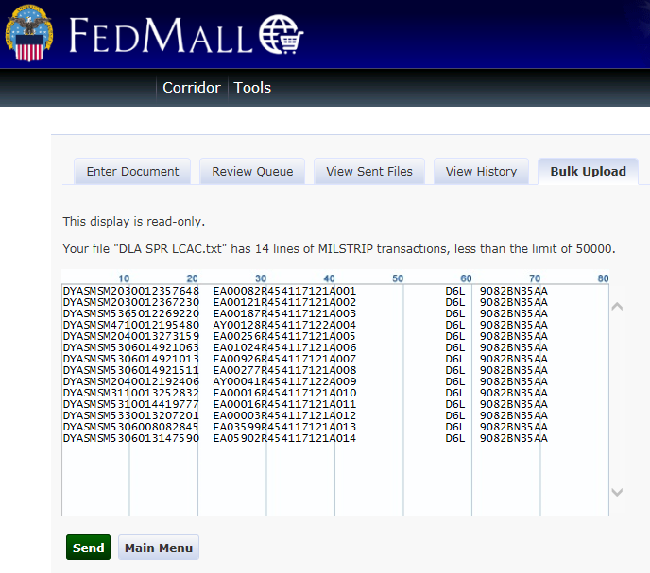
Step By Step Upload
Final review and send

Slide 8
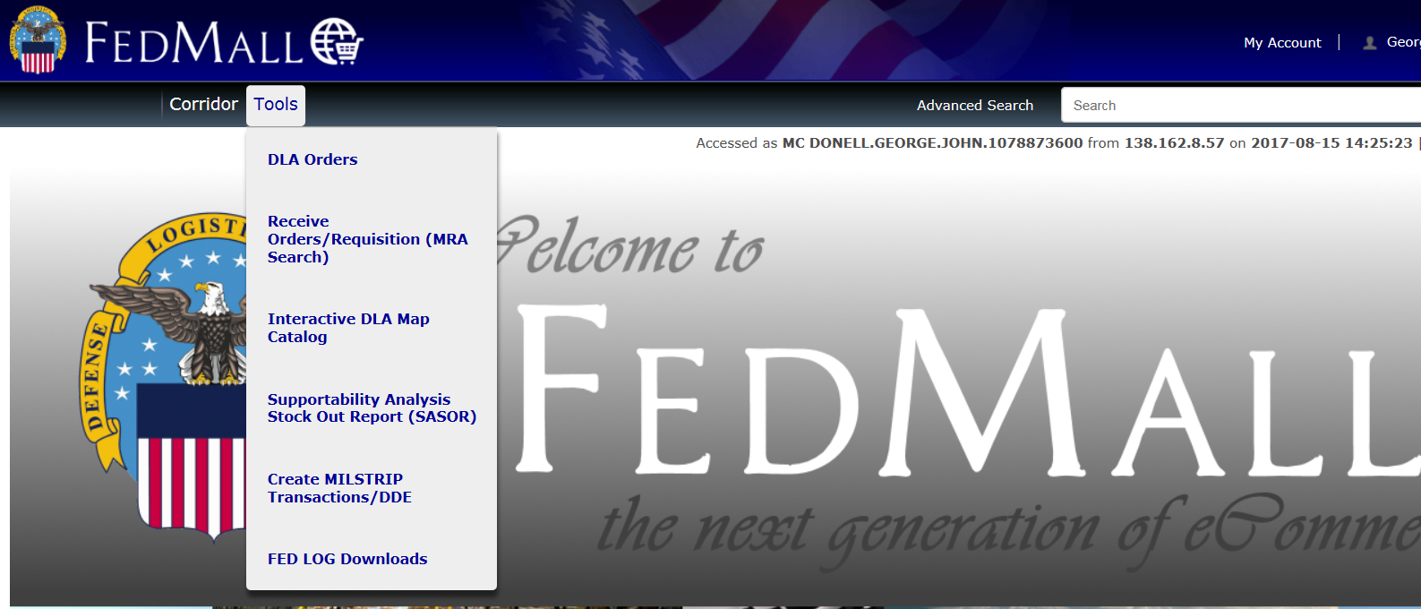
Steps to View/Verify Loaded SPRs
From FedMall Main menu, select DLA Orders

Slide 9
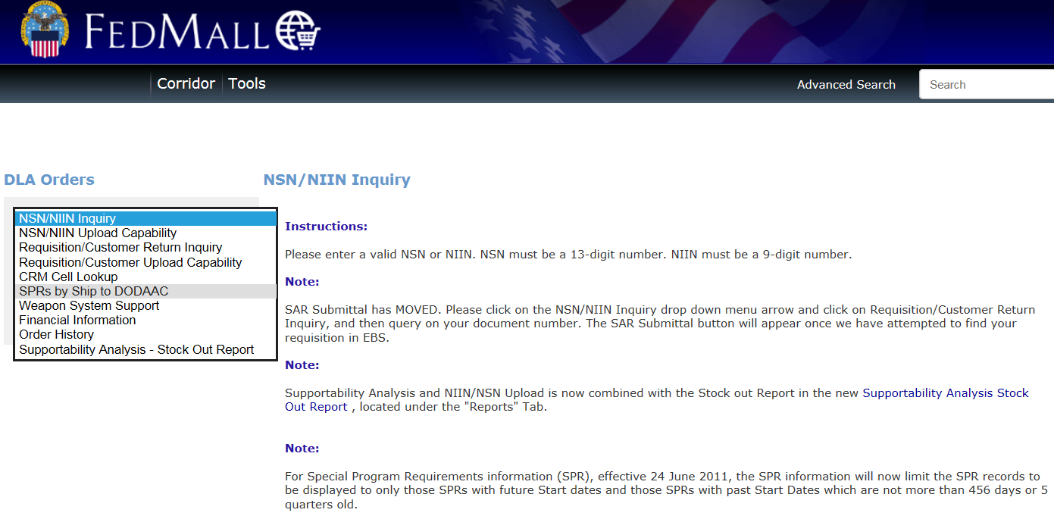
Steps to View/Verify Loaded SPRs
From the drop down, select SPRs by Ship to DODAAC

Slide 10
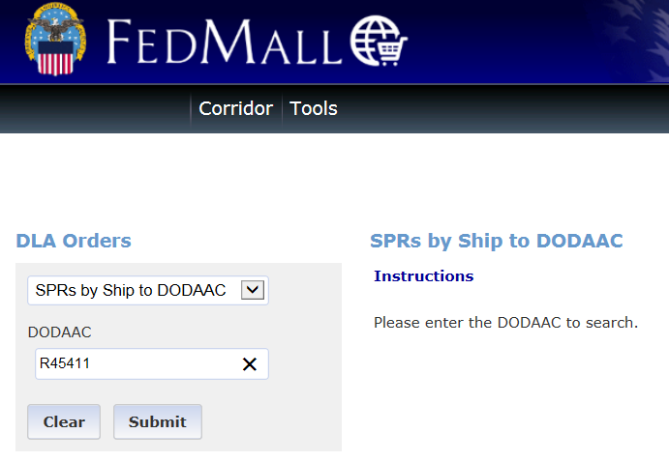
Steps to View/Verify Loaded SPRs
ACU 5 UIC R45411 from the example is entered in the DODAAC block, then submit

Slide 11
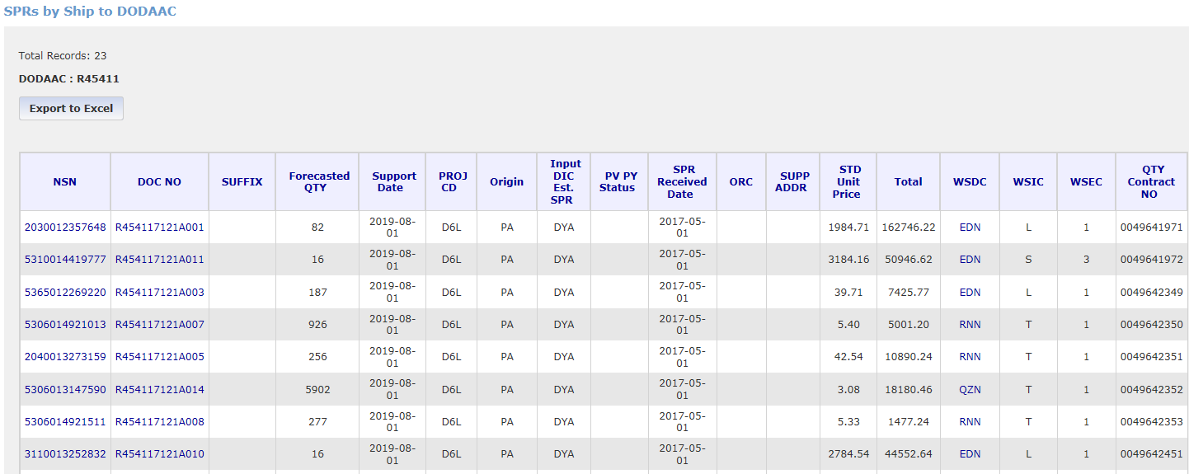
Loaded SPRs
Select Export to Excel

Slide 12
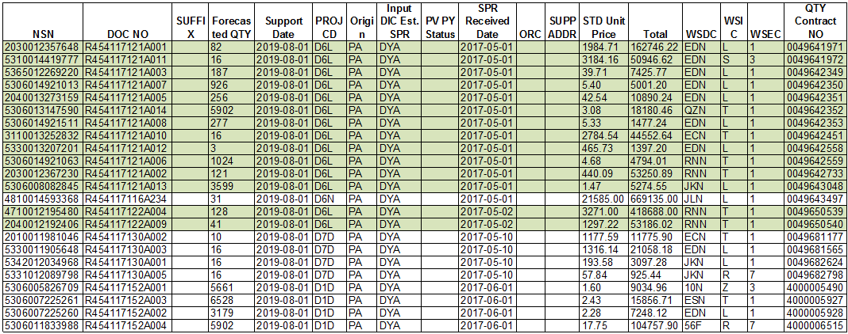
SPR Excel Download File
ACU 5 SPRs submitted in the example have been highlighted in green on the downloaded file
Notes:
Proj Code = ORSI from the SPR submission
Weapon System Essentiality Code (WSEC) are assigned by the submitting activities.
1, Mission Essential
3, Mission Degrading
6, Personnel Safety
7, Environmental/Legal
WSGC and WSEC are used to compute a Weapon System Indicator Code (WSIC) for each NSN
Weapon System Indicator Code (WSIC) correlates to investment tier (Tier I, II, or III) used to prioritize stock buys

Slide 13

References

Slide 14
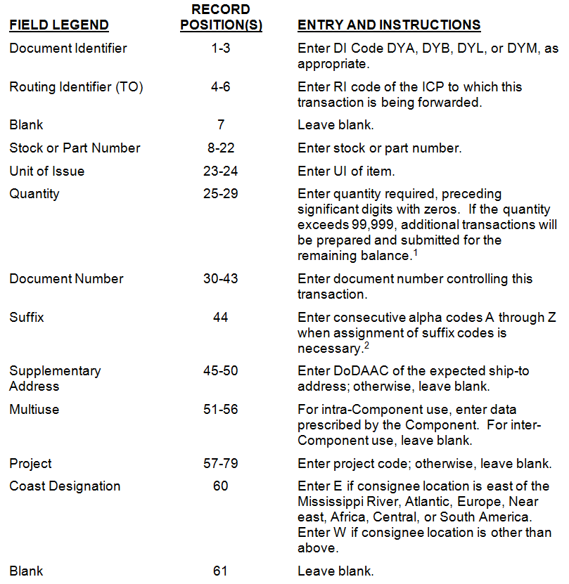
SPR Request

Slide 15
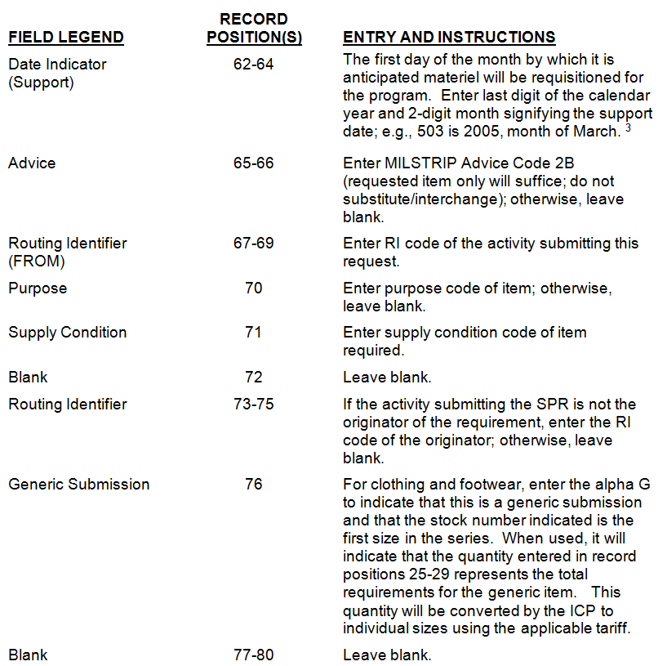
SPR Request

Slide 16
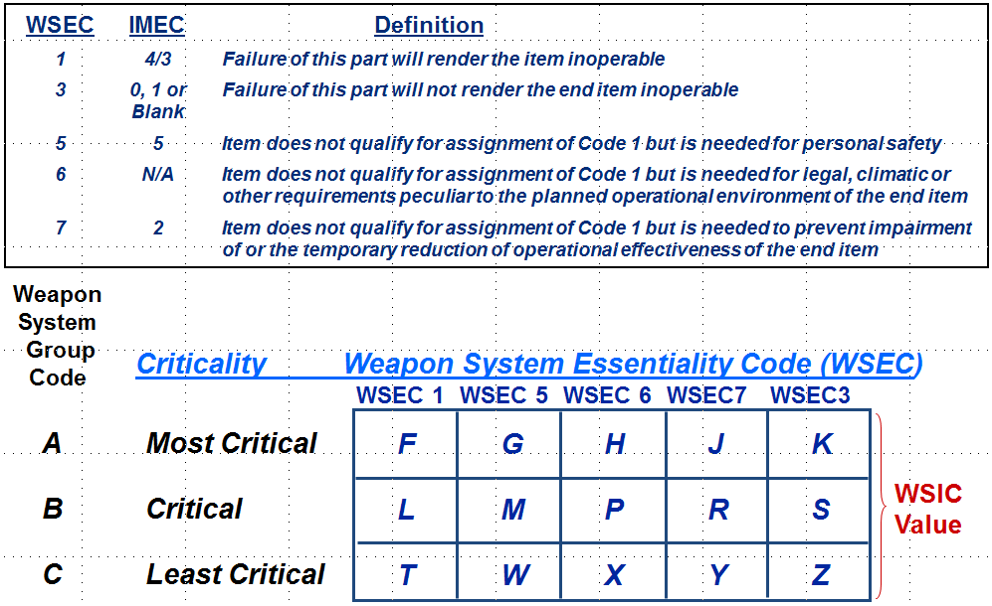
WSEC WSIC Codes

