Slide 1

NAVSUP Weapon Systems Support
presented by:
Craig Pulver

Slide 2
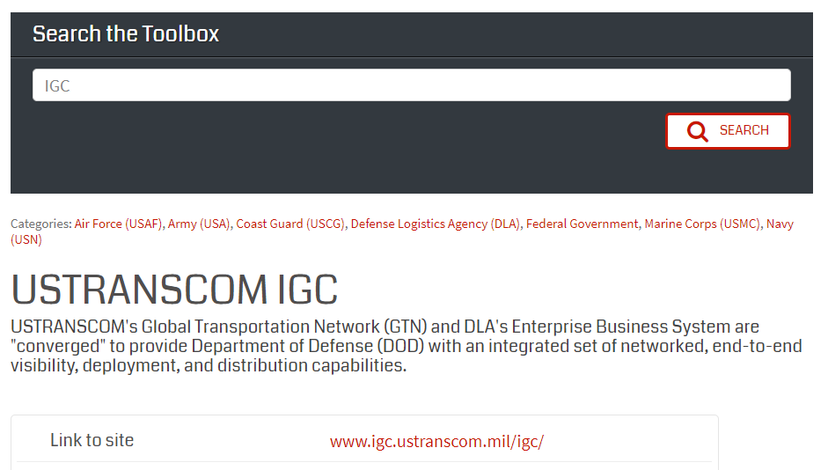
Find IGC in LogTool
The LogTool IGC page provides basic information on the
website and includes a link to the site.
To get to IGC, click on “Link to site” URL.
2

Slide 3
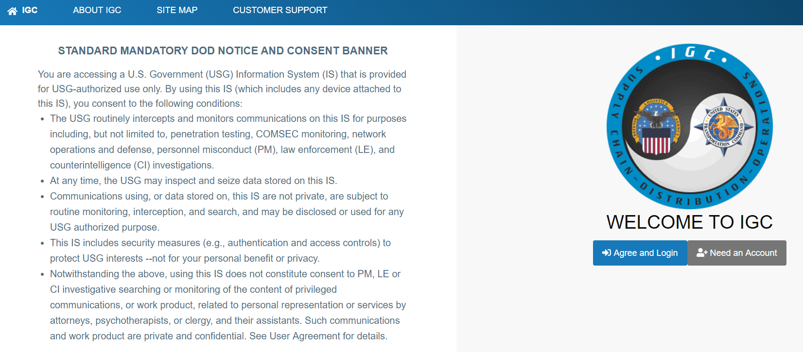
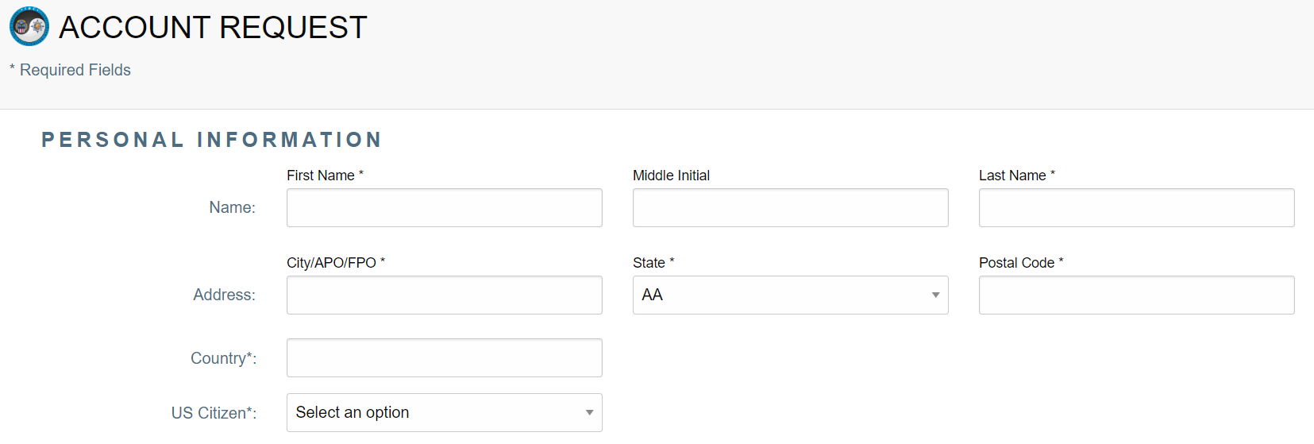
Register for the IGC Program
If you need an account, click on Need an Account and fill out the on line SAR and you will have an account in minutes

Slide 4
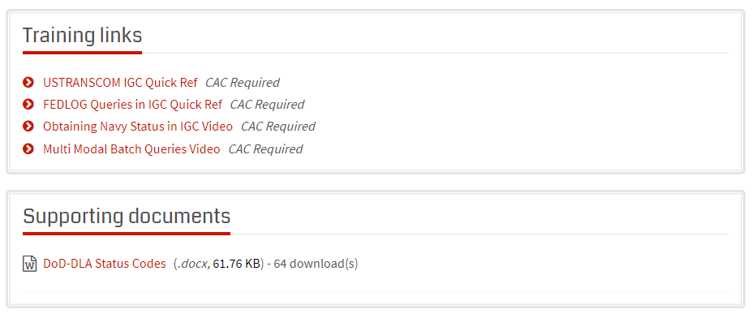
IGC Training in LogTool
Check out the training links on the LogTool IGC web page
USTRANSCOM IGC Quick Ref explains how to do a NIIN query

Slide 5
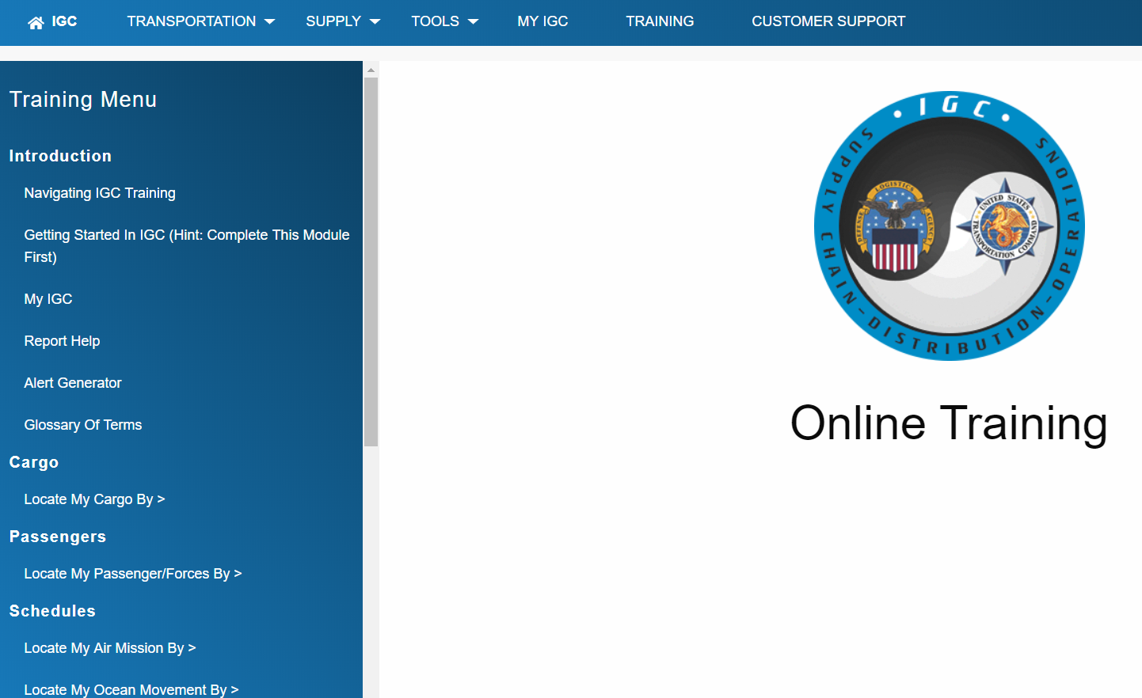
IGC Training
IGC also has a lot of training on line…

Slide 6
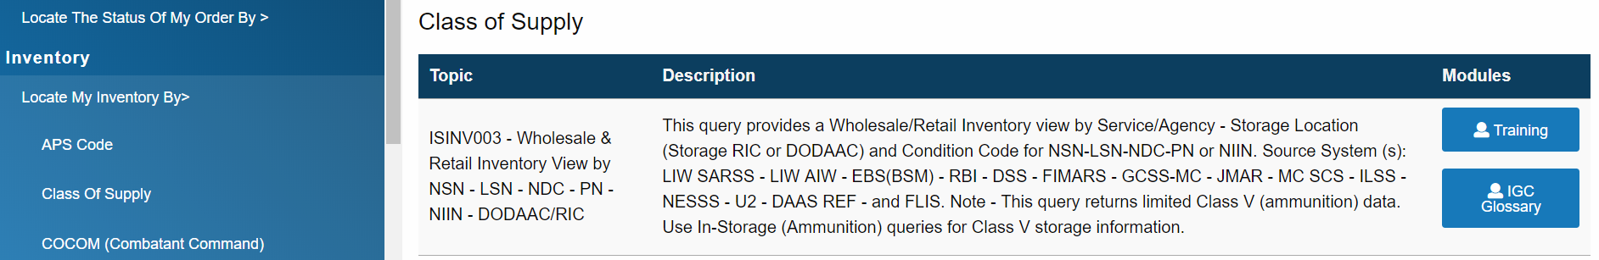
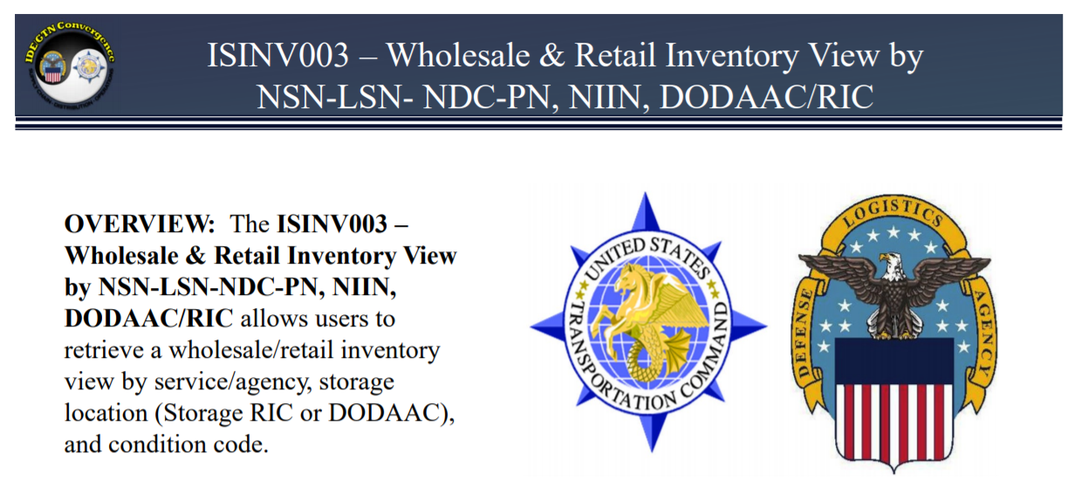
IGC ISINV003 Training
Or check out the IGC training on doing a NIIN query

Slide 7
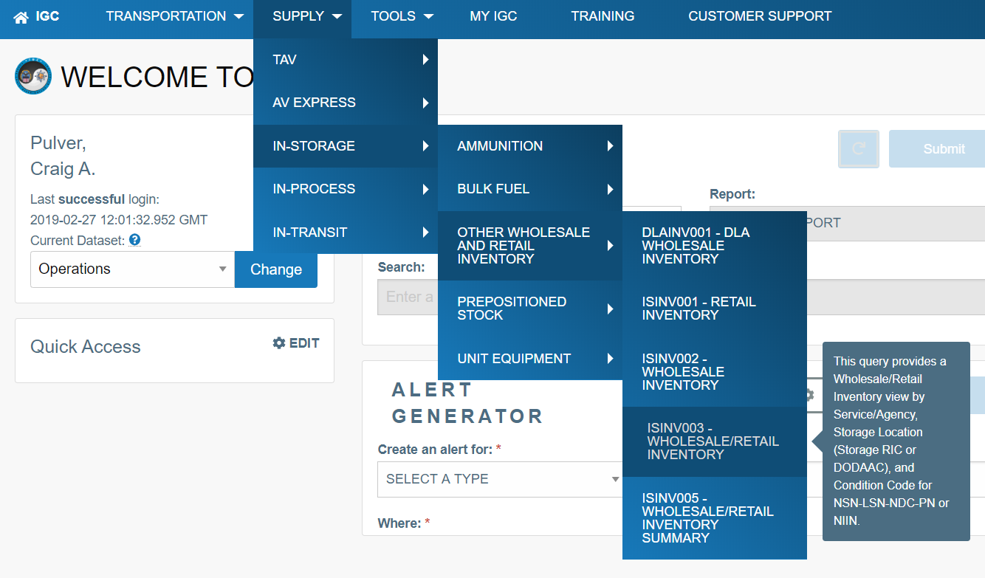
IGC Asset Visibility Check
Follow the link to the ISINV003 query. This will provide on hand and due info

Slide 8
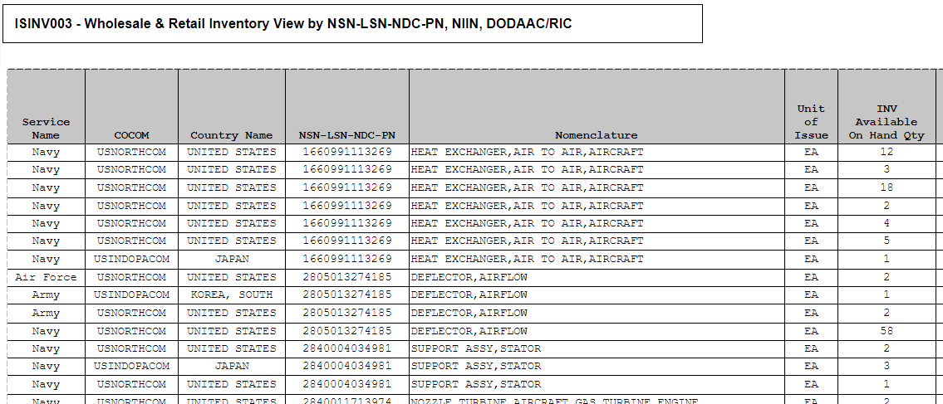
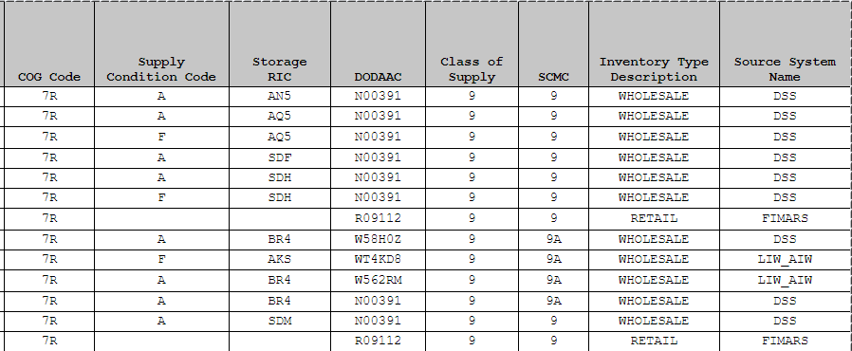
ISINV003 Provided DoD Asset Visibility
Report includes OH, Condition, where material is located and who owns them

Slide 9
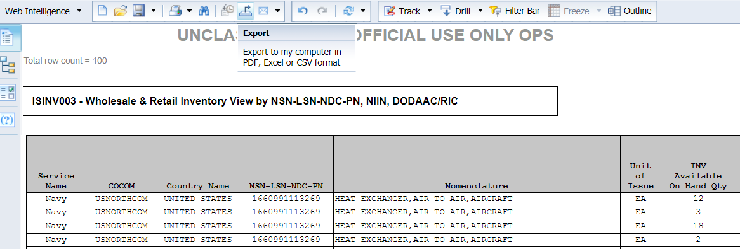
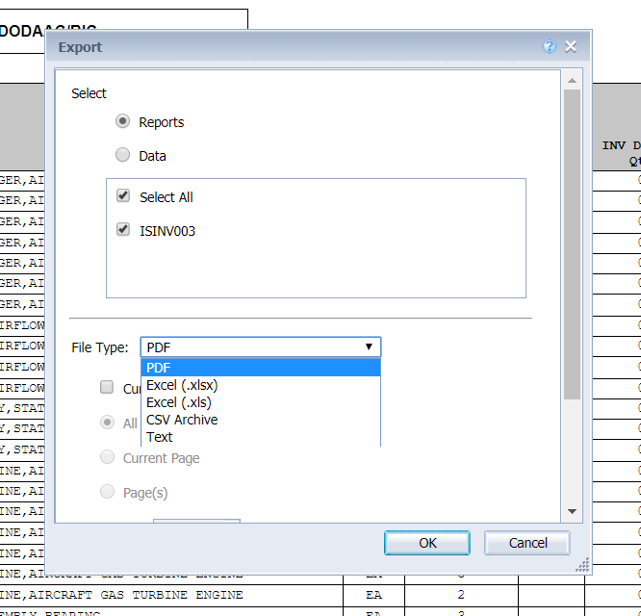
Exporting Data from IGC
Export this report to Excel by clicking on the export symbol, select Excel and click on OK
File will download after you click on OK

Slide 10
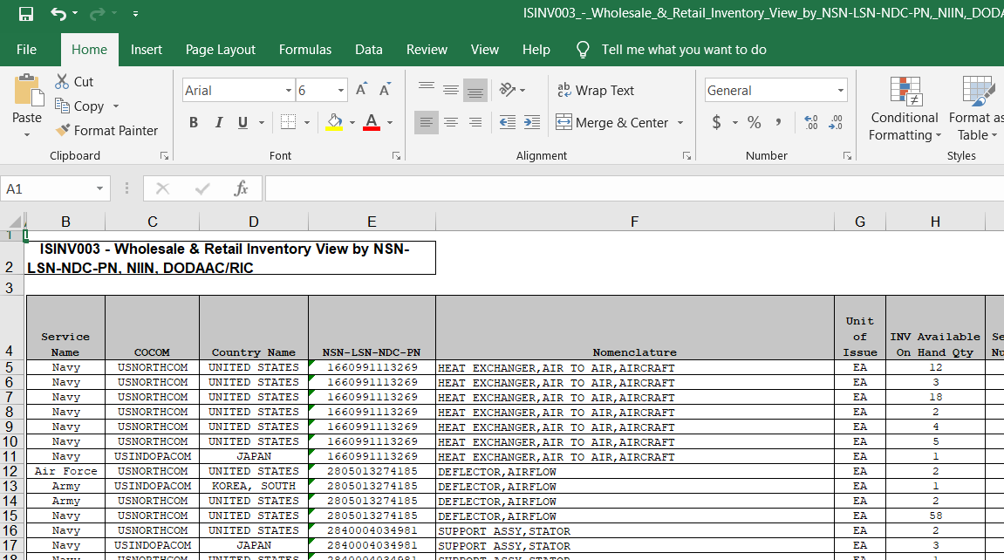
Exporting data into Excel
Now you can manage this date in Excel…

Slide 11
POC Info:
Peter Browne
peter.s.browne@navy.mil
(215) 697-5056
Craig Pulver
craig.a.pulver.ctr@navy.mil
(215) 697-4639
Gary Condit
gary.e.condit.ctr@navy.mil
(215)-697-4726

