Slide 1
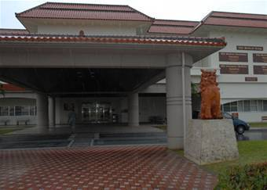
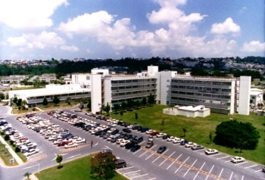
Theater Lead Agent for Medical Materiel – Pacific (TLAMM-P)
Customer Overview

Slide 2
Overview
What is TLAMM-P
Missions Supported
Optical Fabrication
Establishing an Account
Ordering Procedures
Shipping Procedures
Delivery
Turn Ins
Contact Information

Slide 3
What is TLAMM-P
Collaborative effort of 18th Medical Group and US Naval Hospital Okinawa (USNH-O) to provide Health Services Logistics Support to the PACOM theater (outside Korea)
Support joint and coalition medical forces participating in:
  Humanitarian/disaster response, contingencies, major conflicts
  PACOM-sponsored exercises
Services provided:
  Customer support operations
  Class VIII medical materiel sustainment
  Biomedical equipment maintenance by USNH-O
  Optical fabrication by USNH-O
  Patient Movement Item (PMI) hub
  Blood support by USNH-O

Slide 4



Current Missions Supported
Enduring customers:
  Operation Enduring Freedom-Philippines, Joint Special Operations Task Force
  3rd Marine Expeditionary Force Medical Logistics Company
  U.S. Army 1st Special Forces Group
PACOM exercises:
  Key Resolve March 2010 in Korea
  Pacific Angel August 2010 in Sri Lanka

Slide 5
Optical Fabrication
Basic Optical Fabrication requests should be submitted on DD Form 771
http://www.med.navy.mil/sites/nostra/order/Documents/DD771_2008.pdf provides form plus guidance to complete
Forward request to the Optical Fabrication Office at NHOK.SPECTACLES@ FE.NAVY.MIL
Glasses will be sent via MPS

Slide 6
Optical Fabrication
  Frame selections
    FOC - Frame of Choice if accessible (Delta, Elite, Encore, Excel, Sidestreet, Vista, 350)
    MS9 - Male BCG'S
    FS9 - Female BCG‘S
    M40 - Old Gas Mask Inserts
    M50 - New Gas Mask Inserts
    ICE/P2B - Ballistic Goggles Inserts

Slide 7
Establishing an Account
Deployed customers must provide the following information to establish a customer account
Request For Support (RFS)(Service Specific-standardized is currently in the works
  Unit name, designation, and DODAAC or UIC
  Name, rank, contact info for authorized ordering officials
  Funding document….either fund cite, line of accounting, or Military Interdepartmental Purchase Request (MIPR)
  Shipping addresses….both military and commercial
  Any special shipping instructions
  List of commonly used supplies…..or identify the allowance standards, AMALs/ADALs, or unit assemblages that accompanied the deployed unit

Slide 8
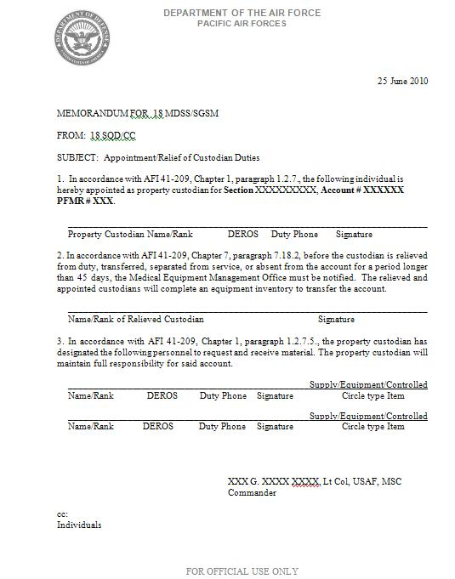
Establishing an Account
Complete and email/fax Custodian Appointment Letter with copy of your unit commander’s “Assumption of Command” or “G-Series Orders” to identify signatory on letter

Slide 9

Ordering Procedures
  Primary ordering methods (preferred)
    Defense Medical Logistics Standard Support system (DMLSS)
    Web-based TLAMM Reachback application (web portal) at Air Force Medical Logistics
    DMLSS Customer Assistance Module (DCAM)
  Alternate ordering methods (least preferred)
    Email order to TLAMM-Pacific@Kadena.af.mil
    Fax orders to DSN 315-630-4681 or Commercial fax 011-81-611-730-4681

Slide 10
Ordering Procedures
TLAMM-P will build your customer catalog from the list of commonly used supplies or your allowance standards, AMAL/ADAL, or unit assemblage
Order any item in your customer catalog using DMLSS, the web portal, or DCAM
Items not in your customer catalog require a New Item Request (NIR)….located on the web portal or use a manual DD Form 1348-6, DOD Single Line Item Requisition System Document
Biomedical equipment maintenance….call or email TLAMM-P to coordinate support
Optical fabrication and blood support….add USNH-O contact information

Slide 11

Shipping Procedures
Distribution methods (off-island customers)
  18th Logistics Readiness SQ Transportation Mgmt Office
    TMO coordinates movement via MILAIR or commercial carriers
    Tasking/deployment orders required for airlift support
  Special handling requirements for HAZMAT, refrigerated or frozen items, and controlled substance shipments
    Hazardous cargo will take longer to arrive
    Controlled temperature shipments require coordination to ensure customer is available to receive shipment at destination
    Controlled substance shipments require signature service, either via MILAIR or commercial carrier
Distribution methods (on-island customers)
  Customer picks up shipment at 18th MDG warehouse, building 626

Slide 12
Delivery
TLAMM-P processes issue requests daily and ships as agreed upon by both activities
Non-emergency orders will be shipped weekly
  Provisions for more frequent orders can be coordinated as mission requirements dictate
  Emergency orders will be shipped immediately if stock is on-hand or once stock arrives
Receipt confirmation….notify TLAMM-P upon item receipt via the web portal or email
  Confirmation closes the supply chain loop or identifies shipping discrepancies

Slide 13
Customer Turn-Ins
Customers should redistribute or dispose of excess materiel locally
When not possible, TLAMM-P may accept customer returns (see form on next slide for sample format)
Turn-ins must meet the following criteria
  Dated materiel must have at least 12 months remaining potency
  Cumulative value is greater than $250
  18th MDG has an immediate need by another customer
Normally, customer will not receive credit
TLAMM-P must approve the return prior to shipment
Prior to return, complete form on next slide and email to TLAMM-Pacific@kadena.af.mil for disposition

Slide 14
Customer Turn-In Form
HAZMAT | NSN | DESCRIPTION | UNIT OF ISSUE | EXP DATE | QTY | UNIT PRICE | TOTAL PRICE
No | 6505-00-985-7301 | Tylenol | BT | 11-Nov | 4 | $5.41 | $21.64
No | 6505-01-431-0402 | P | BT |  | 2 | $3.93 | $7.86
No | 6505-00-100-9985 |  | BT |  | 2 | $0.57 | $1.14
No | 6505-01-449-1635 |  | BT | 10-Sep | 4 | $7.37 | $29.48
No | 6505-00-118-2759 |  | BT |  | 4 | $3.07 | $12.28

Slide 15
TLAMM-P Contact Info
Optical Fabrication Lab
DSN 315-643-1015
NHOK.SPECTACLES@ FE.NAVY.MIL
NCOIC, TLAMM-P
DSN 315-630-4928/ 5544/ Mobile 011-81-080-2721-0395
NCOIC, Inventory Management
DSN 315-630-0023
NCOIC, Medical Materiel
DSN 315-630-4006
Superintendent, Medical Logistics
DSN 315-630-4369
Medical Logistics Flight Commander
DSN 315-630-4170
email: TLAMM-Pacific@kadena.af.mil

