Slide 1

NAVSUP Weapon Systems Support
presented by:
Craig Pulver

Slide 2
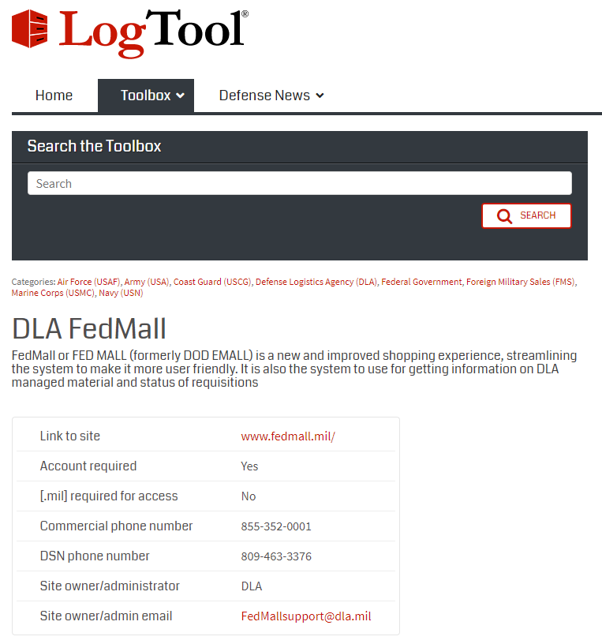
Find FEDMALL in LogTool
The LogTool FEDLOG page
provides basic information on the
website and includes a link to the site.
To get to FEDMALL, click on
“Link to site” URL.
2

Slide 3
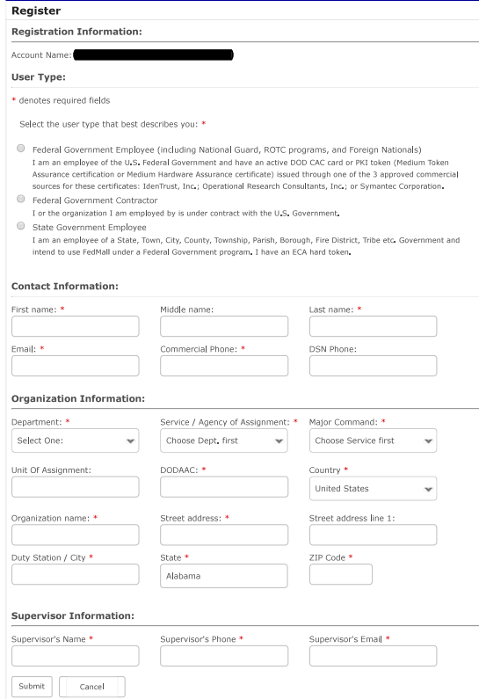
Register for FEDMALL
Unlike the Navy SAAR-N, the FEDMALL program has an on-line SAAR which requests just a couple of things
On FEDMALL home page, in the upper right hand corner is where you login or register and if you have any problems, a link to the Help Desk
When you are done, click on submit

Slide 4
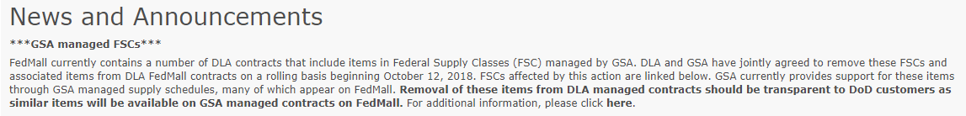
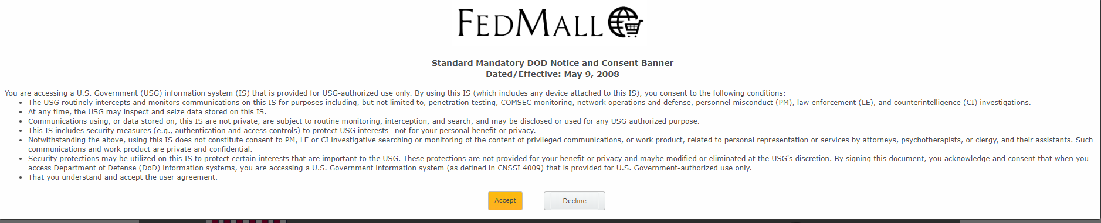
FEDMALL Login
Once you gain access, click on Sign In
Read the News and Announcements to see if any have anything to do with what you are trying to do
Next for the standard warning, click on Accept

Slide 5
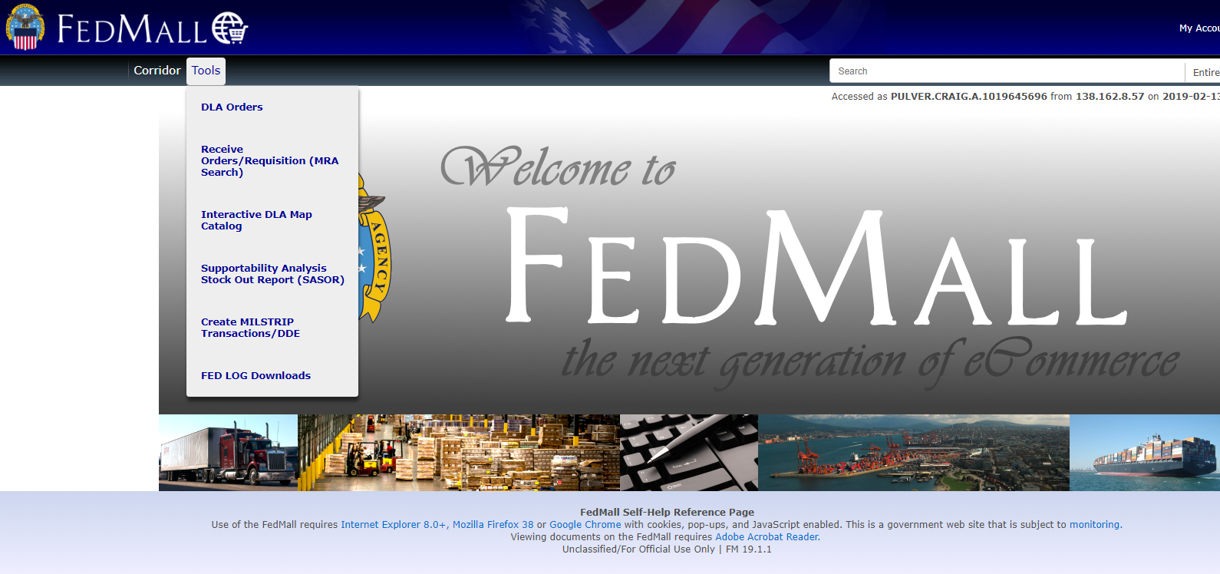
FEDMALL Home Page
On the FEDMALL Home Page, mouse over Tools to access the
capabilities of FEDMALL. Select DLA Orders

Slide 6
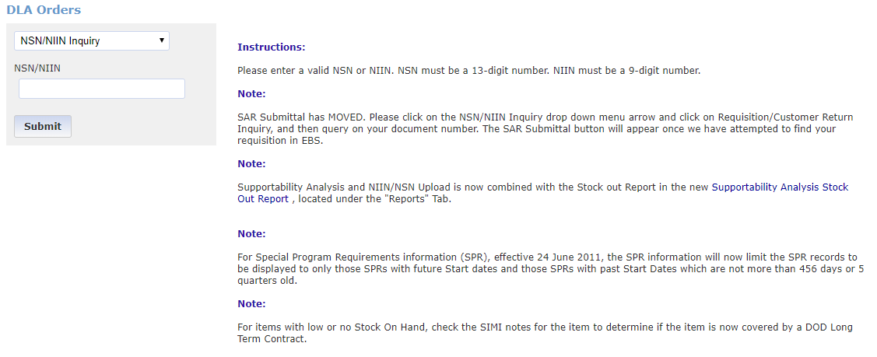
FEDMALL NSN/NIIN Query
Since most people ask the question “do you have any”, FEDMALL starts with
a NSN/NIIN query

Slide 7
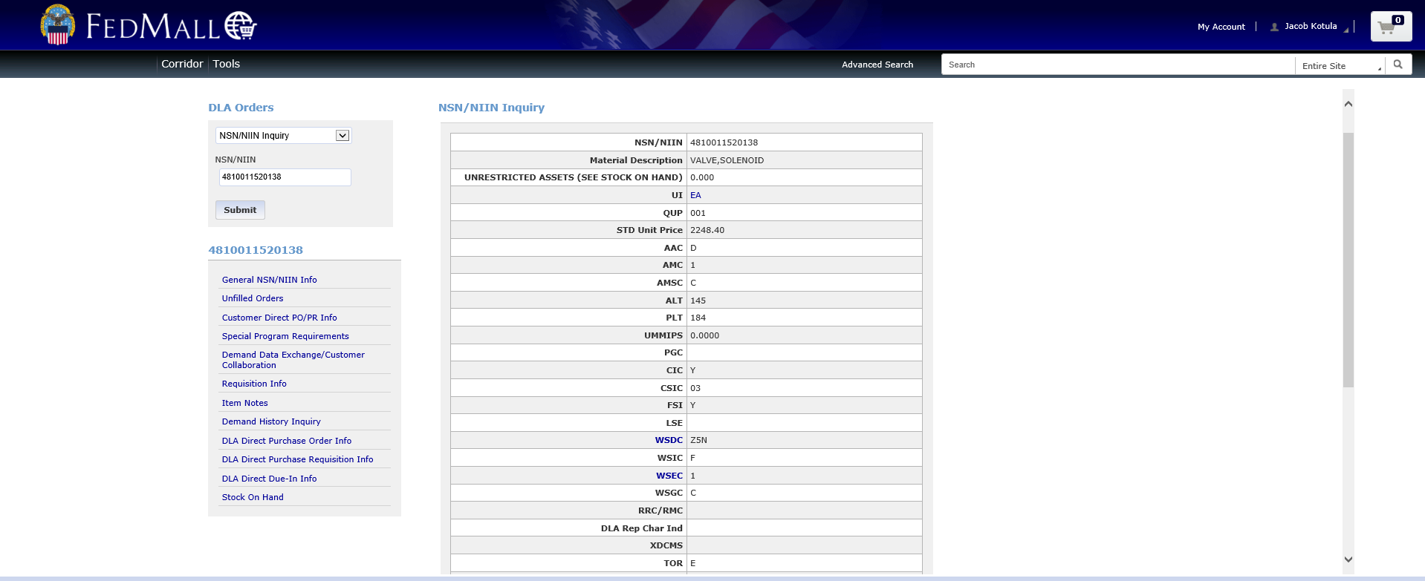
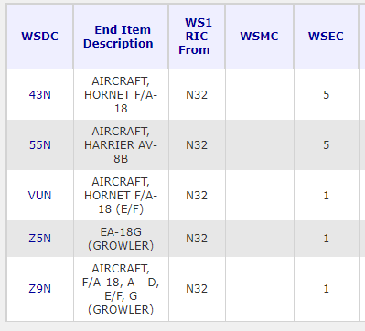
FEDMALL NSN/NIIN Response
The NSN/NIIN response contains basic data and on hand unrestricted assets
Click on WSDC to see what
this part is registered against

Slide 8
Common Acquisition Advice Codes (AAC)
AAC-D Centrally managed by DLA, stocked and issued. Not subject to any specialized controls or restrictions other than those imposed by the Integrated Materiel Manager/Military Service Supply Policy (IMM)
AAC-H (DVD) Direct delivery under a central contract number, Vendor Stocked. Not subject to any specialized controls or restrictions other than those imposed by the IMM
AAC–J (DVD) Not stocked, centrally procured, procurement initiated upon receipt of requisition
AAC-L Local purchase, non-stocked, DLA/GSA/Service/Agency managed
AAC-V Terminal Item, identifies item in stock but future procurement is not authorized. Requisitions can continue to be submitted until stock is exhausted.
AAC-Y Terminal Item, non-stocked, further procurement is not authorized, no wholesale stock available
AAC-Z Insurance/Numeric Stockage Objective Item. Items which are required occasionally, and are centrally managed and issued

Slide 9
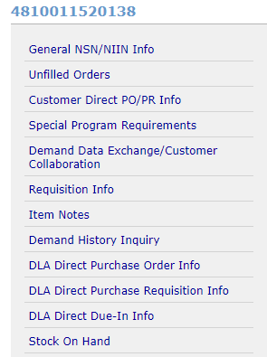
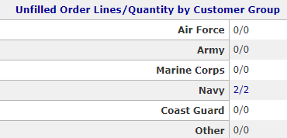
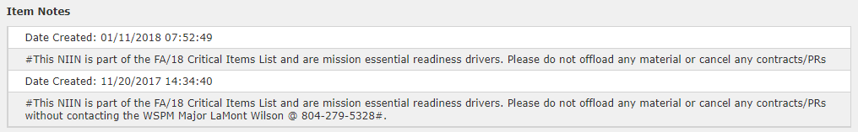
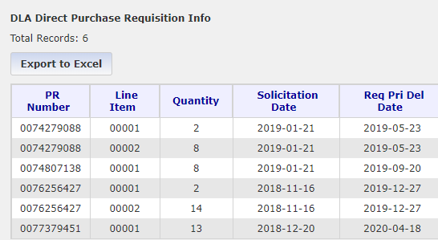

The NSN/NIIN Menu
By clicking on any of menu items, a more
in depth picture can be obtained

Slide 10
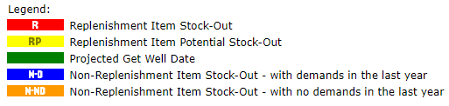
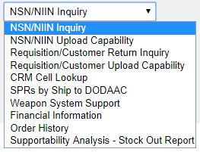
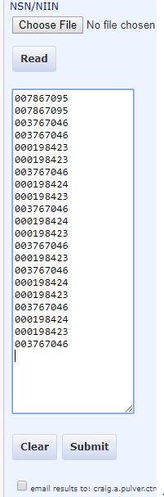
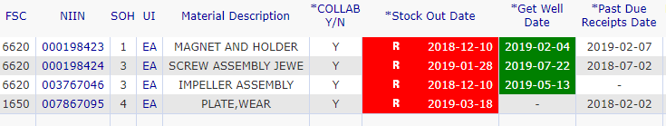
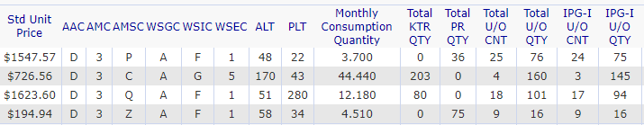
NSN/NIIN Upload Capability
When clicking on the down arrow, a new menu opens up, giving more options.
By selecting NSN/NIIN Upload, up to 300 NSN/NIINs could be added.
If there are more than that, have the response returned by email.
The resulting screen is actually a
Supportability Analysis – Stock-Out Report
Click on any NIIN for a NSN/NIIN view

Slide 11
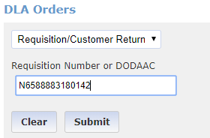
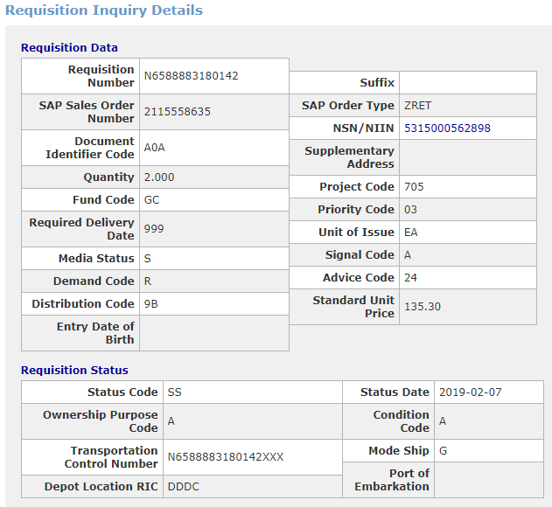
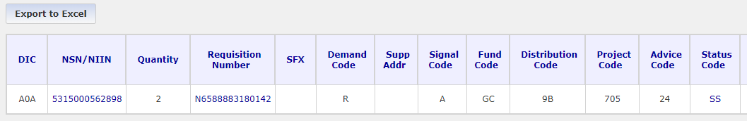
Requisition Number Query
By clicking on the requisition number,
requisition details will be returned.
A SAR can also be submitted.

Slide 12
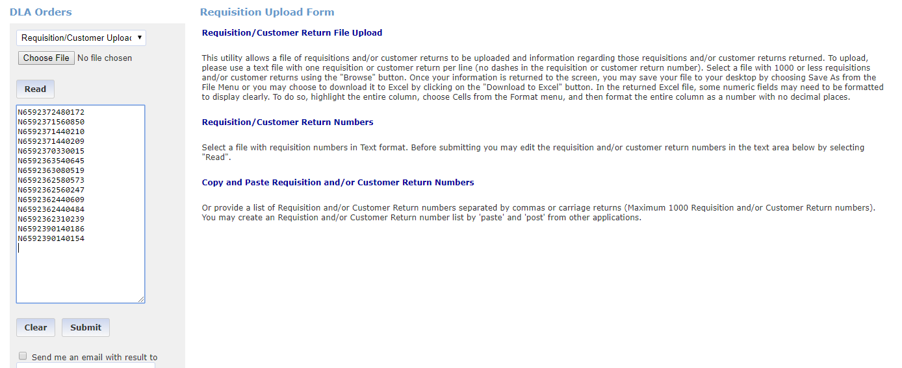
Requisition Customer Upload
When selecting Requisition Customer Upload, up to 1,000 requisitions can be entered
and instead of waiting, have the response emailed

Slide 13
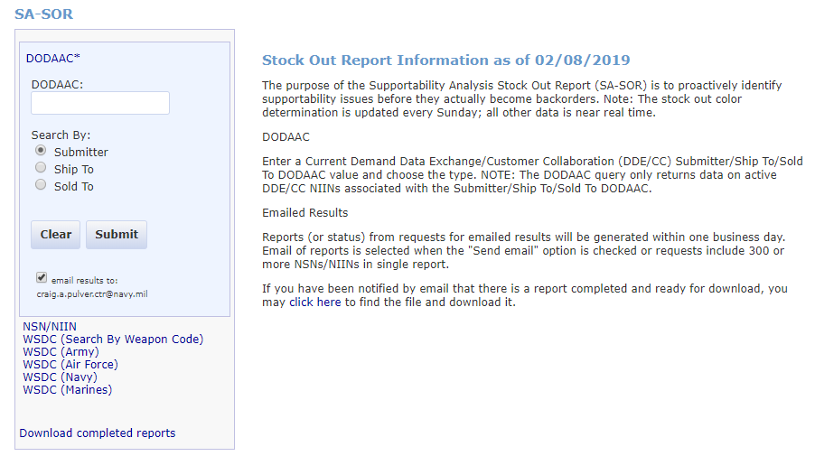
SA-SOR WSDC Query
To obtain all of the DLA managed NIINs for a Navy Weapon System
Designator Code (WSDC), select SA-SOR, click on email returned to:
and finally select WSDC (Navy)

Slide 14
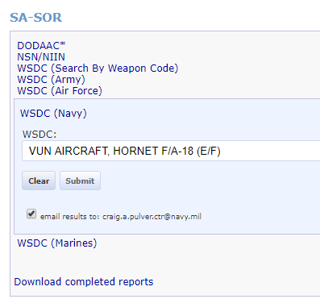
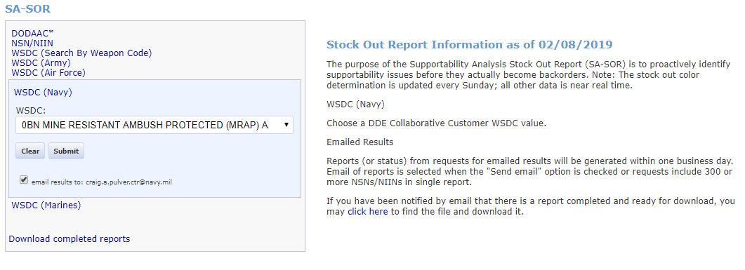
SA-SOR WSDC Query
Select a Navy Weapon System needed, click on email report and then click on submit.
You will receive an email telling you the report is complete.
Log back into FEDMALL, go to SA-SOR and click on Download completed reports

Slide 15

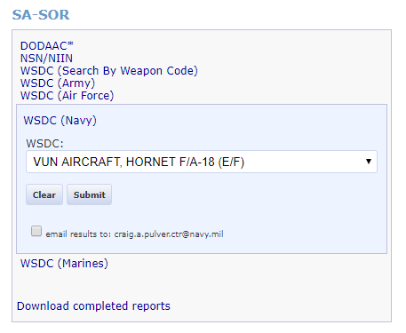
FEDMALL SA-SOR Response
When you click on email response, an email will be returned letting you know the
Report is ready for download. Go back to the FEDMALL SA-SOR menu and
click on Download completed reports.

Slide 16
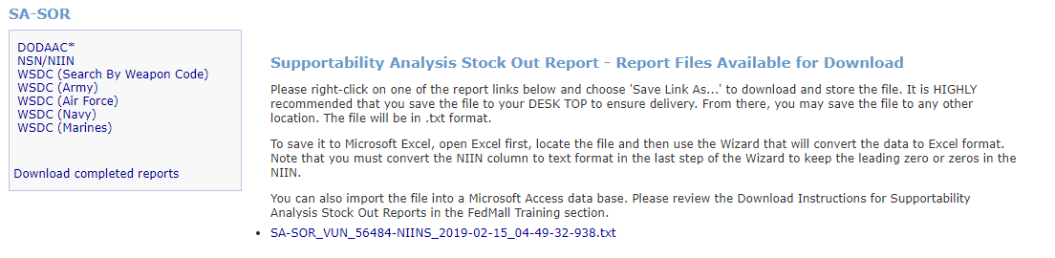

Downloading the report
The file will download in your browser and click on the downloaded file and it
will open in your file of choice. I use Notepad.
Click on the file to open it

Slide 17
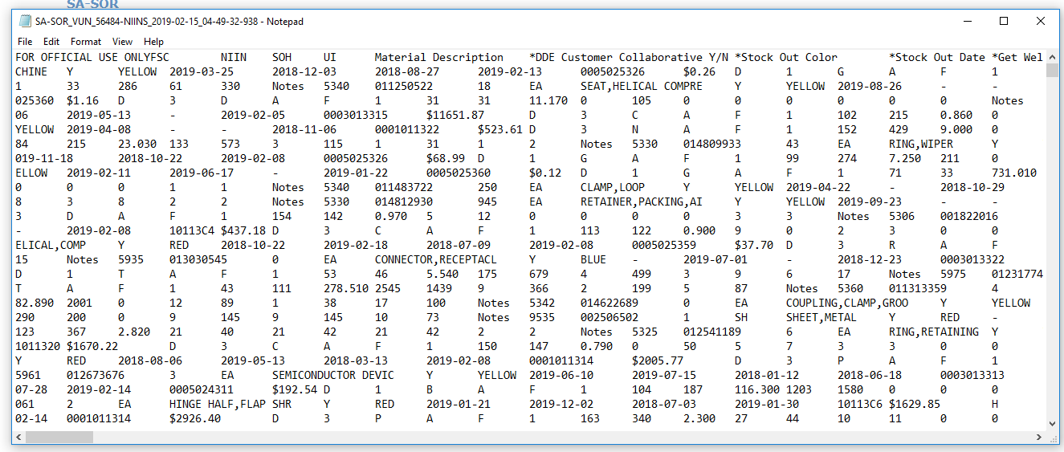
Downloading the report
File will open

Slide 18
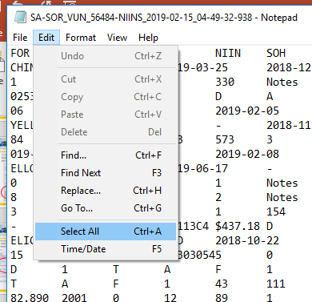
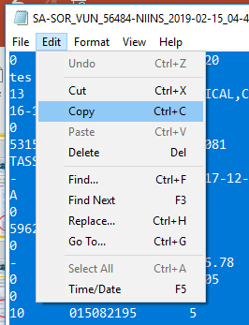
Copying the text file
In Notepad (if you opened the file in Notepad)
Click on Edit, then Select All and then Copy

Slide 19
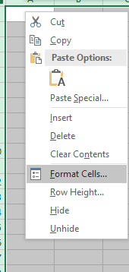
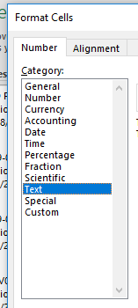
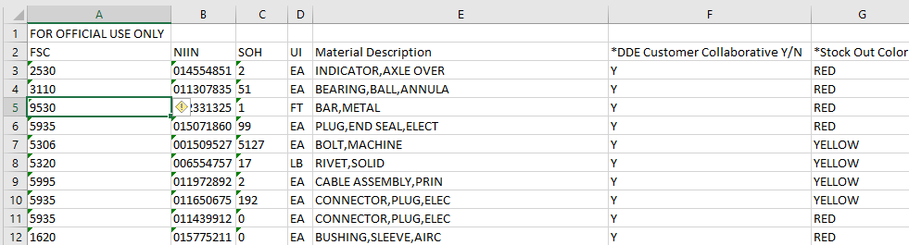
Putting the data into a spreadsheet
Format your spreadsheet as Text and then click on Excel cell A-1 and then paste the data. Now you have a SA-SOR record of every NIIN registered to the weapon system you selected. This will identify stock on hand and which NIINs are in trouble and which will be in trouble.

Slide 20
POC Info:
Peter Browne
peter.s.browne@navy.mil
(215) 697-5056
Craig Pulver
craig.a.pulver.ctr@navy.mil
(215) 697-4639
Gary Condit
gary.e.condit.ctr@navy.mil
(215)-697-4726

